Slide 1
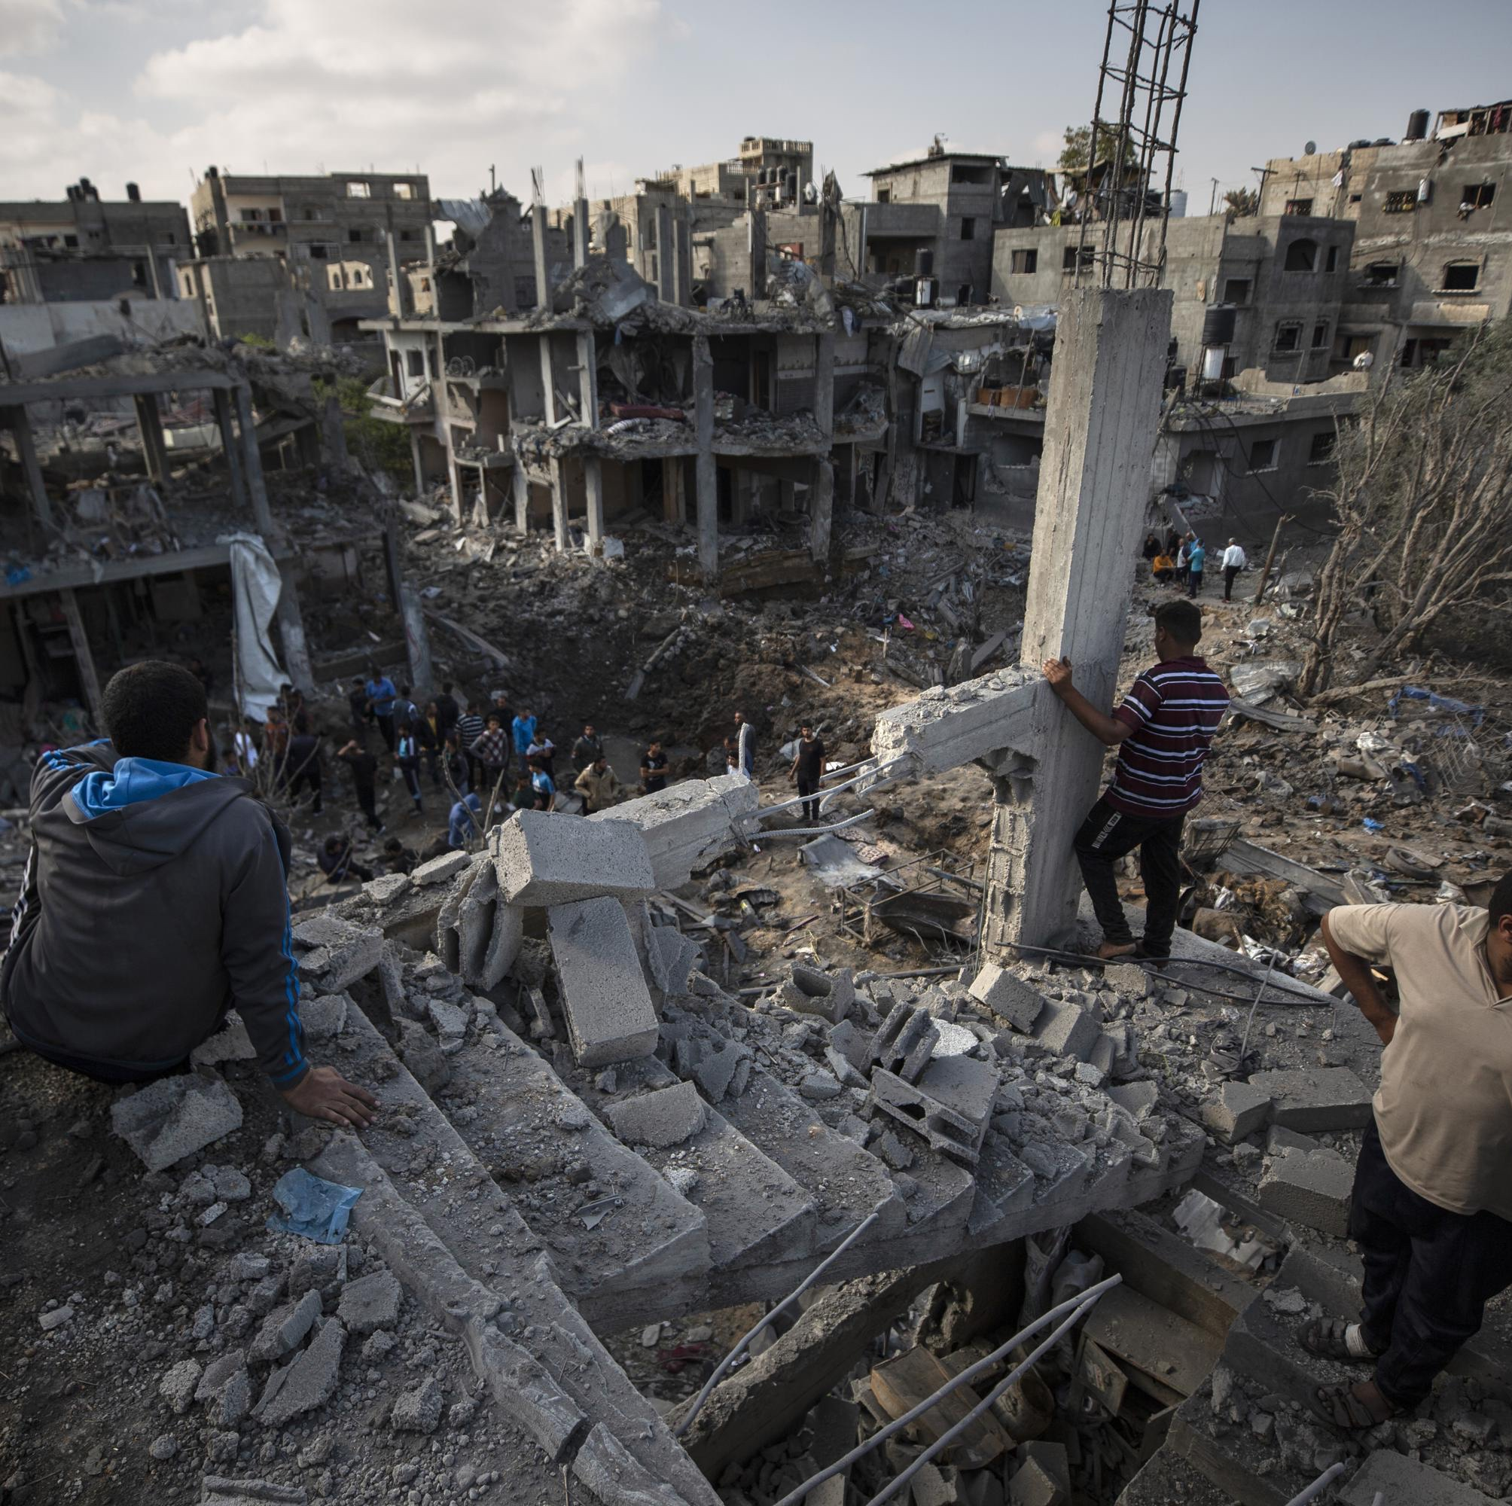
What should be done about the situation in Palestine-Israel?
Lesson 20

Slide 2
Learning objectives
By the end of this lesson, you should be able to:
Describe the main changes over time in Palestine-Israel
Explain the main changes over time in Palestine-Israel
Suggest what should be done about the situation in Palestine-Israel

Slide 3

Chapter Three Recap

Slide 4
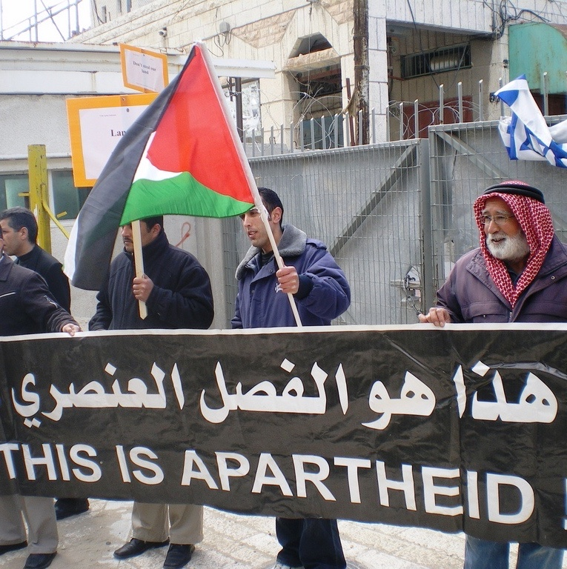
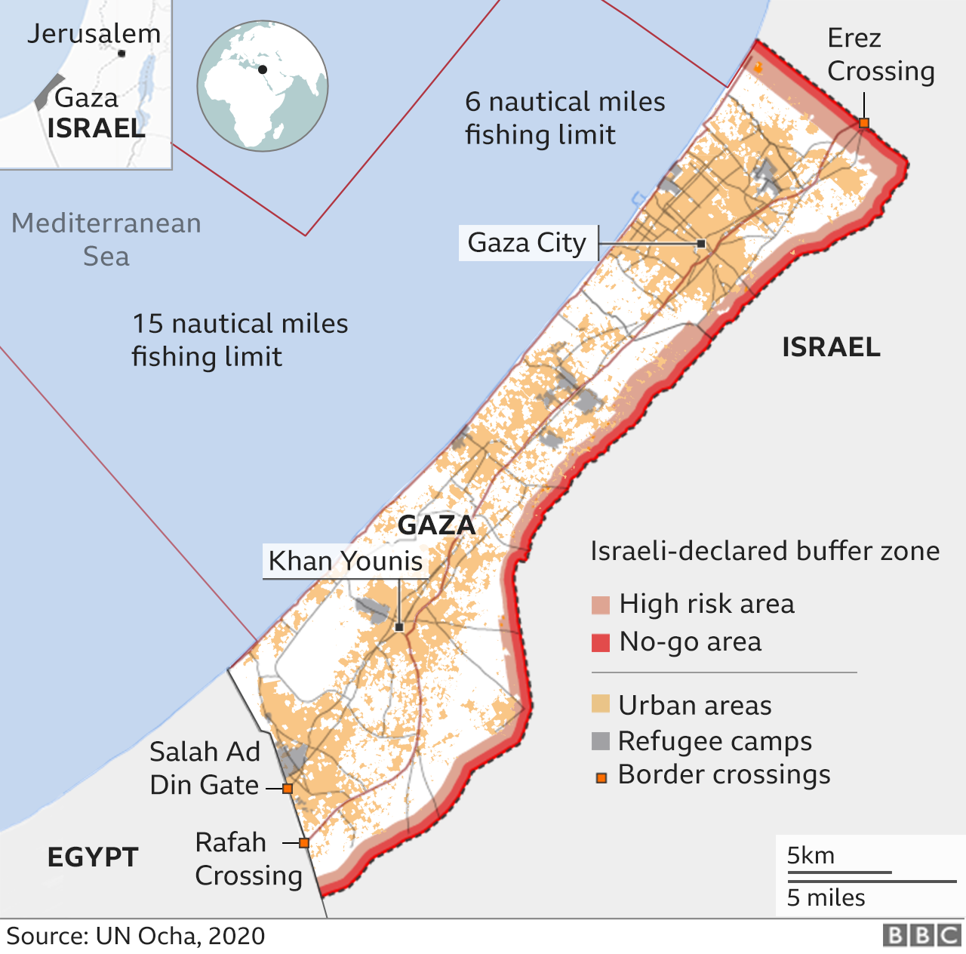
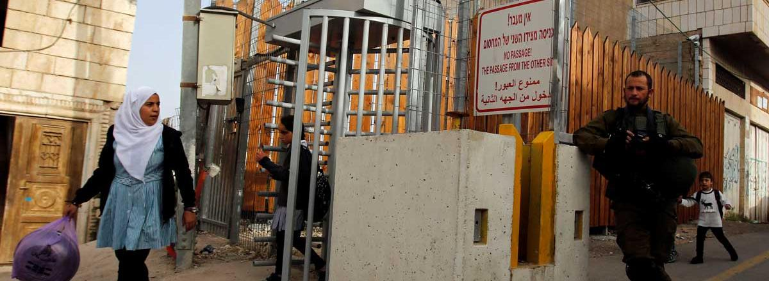
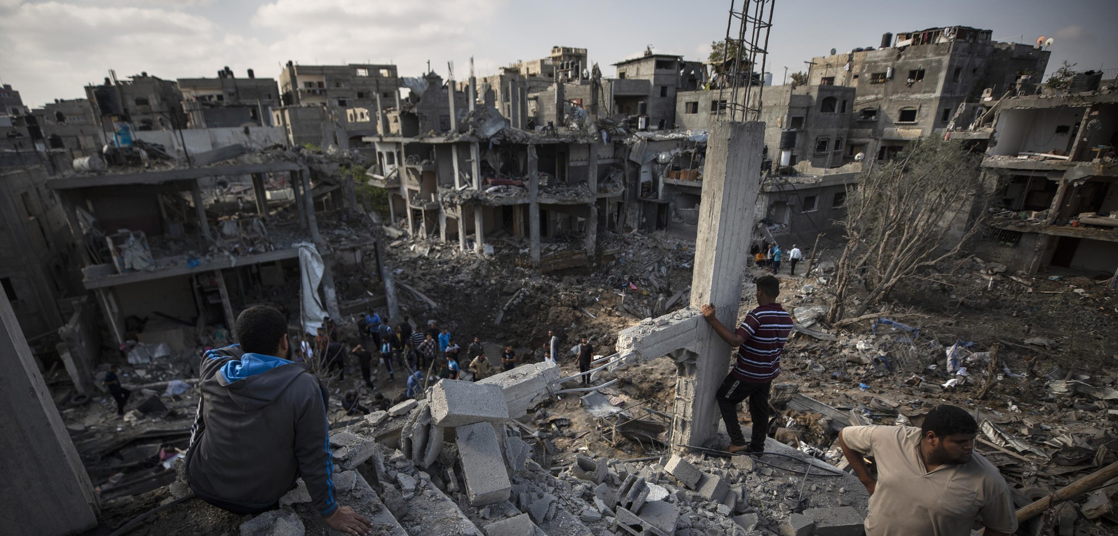
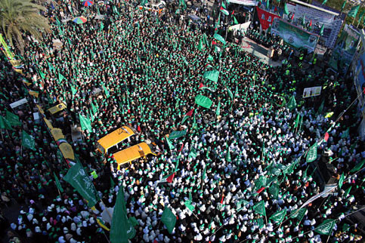
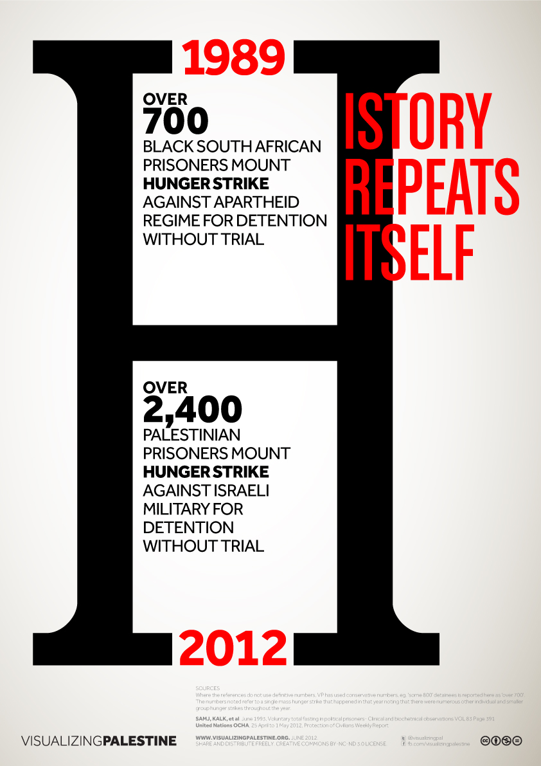
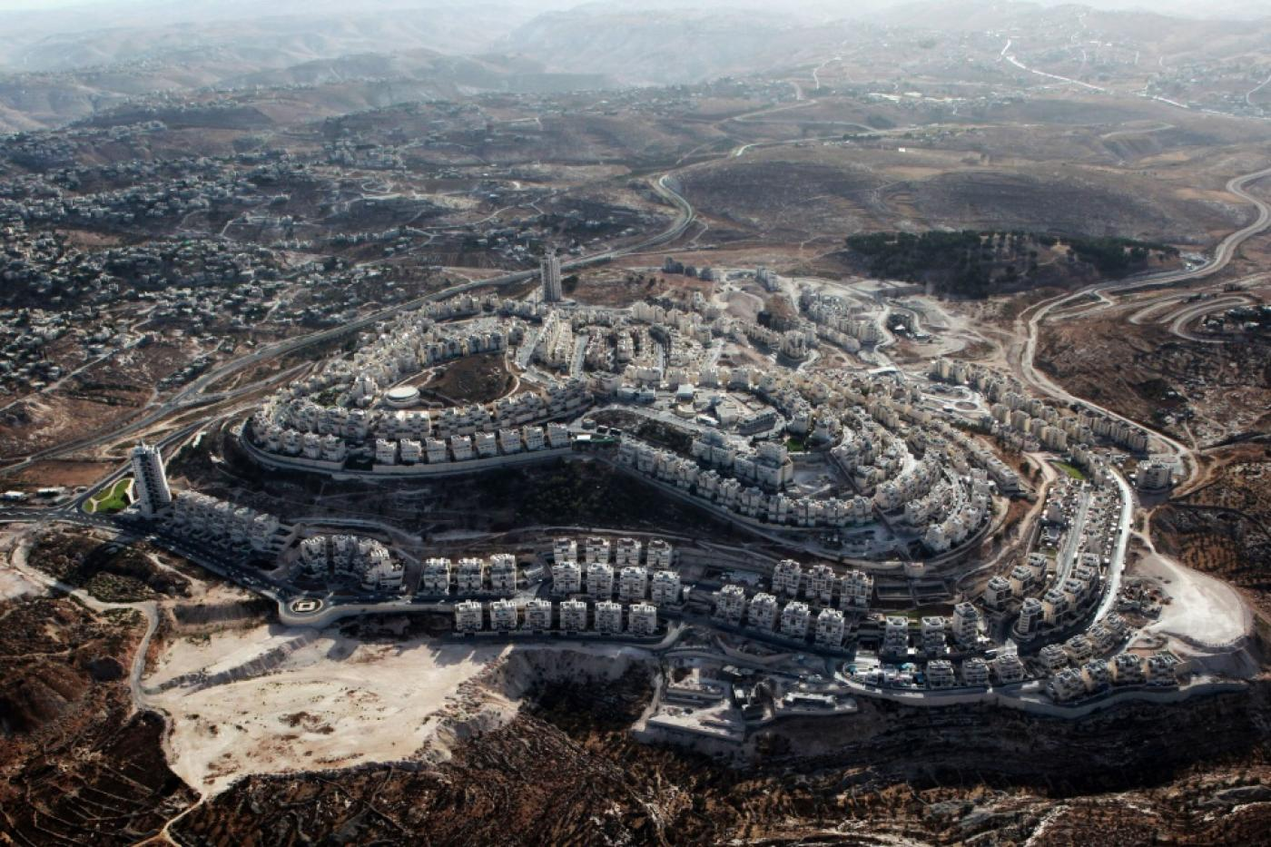
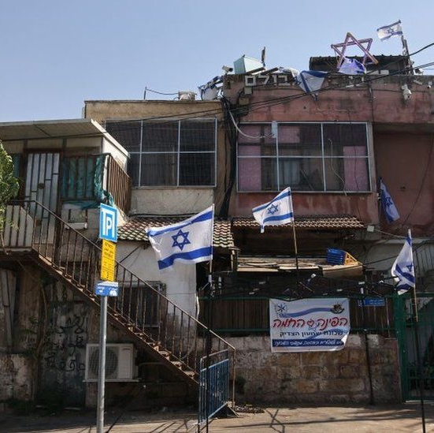
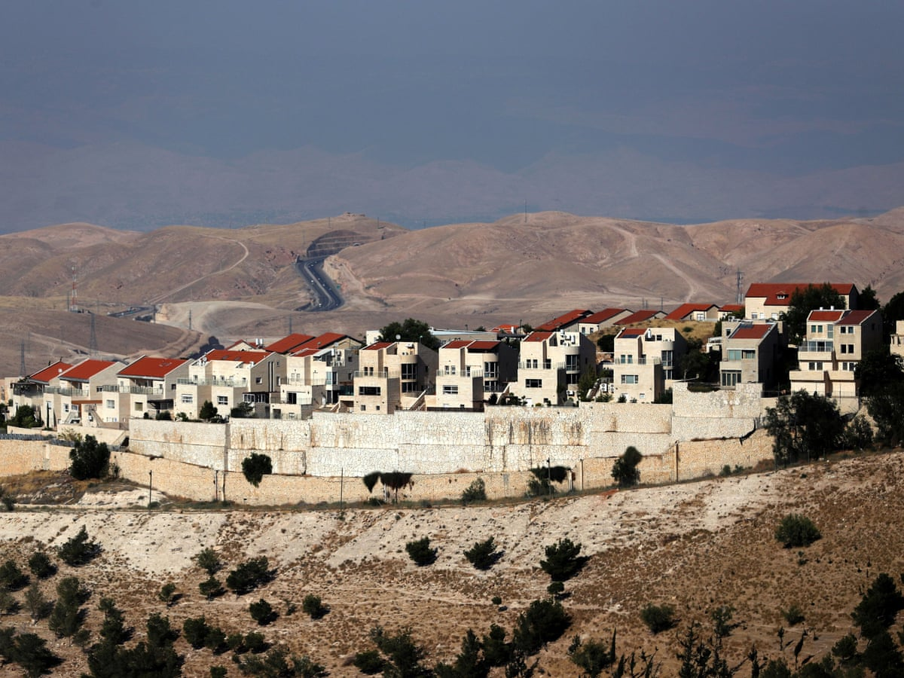
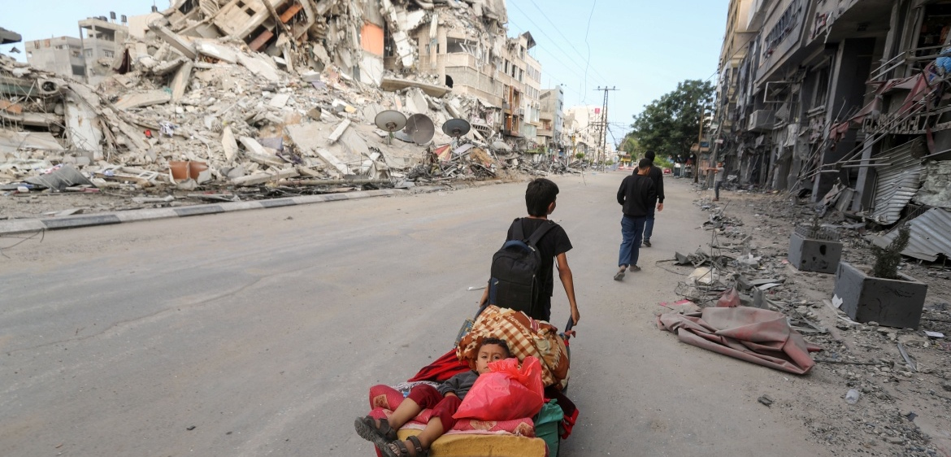
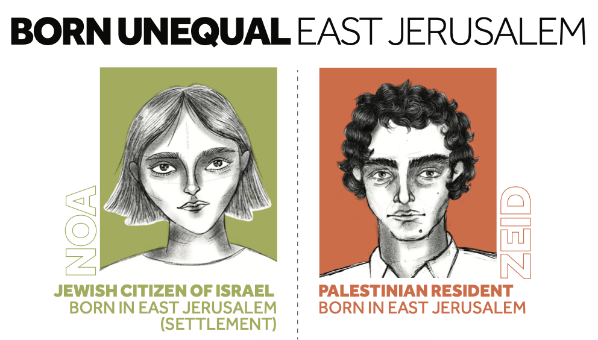
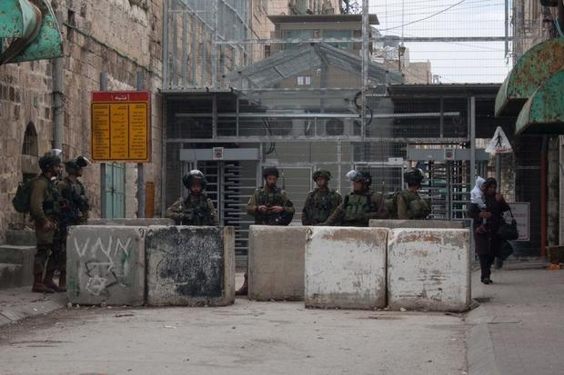
What did we cover in Chapter 3?

Slide 5
What did we cover in Chapter 3?
L14: What happened in the 2006 Palestine election?
L15: What are the consequences of the blockade on Gaza?
L16: What is the impact of illegal Israeli settlements in the West Bank?
L17: What are the consequences of Israel’s illegal annexation of East Jerusalem for Palestinians?
L18: How does life differ for Palestinians and Israelis inside Israel?
L19: What comparisons can be drawn between Palestine-Israel and elsewhere?
L20: What should be done about the situation in Palestine-Israel?

Slide 6
You are now going to be allocated an exam-style question on Chapter 3
Plan an answer in your book and be prepared to explain your answer to the rest of the class
Explain two consequences of illegal Israeli settlements in the West Bank (8 marks)
Write a narrative account analysing the key events that led to Israel imposing a blockade on Gaza in June 2007 (8 marks)
Explain two of the following:
  The consequences of the blockade on Gaza
  How life differs for Palestinians and Israelis inside Israel
  The value of comparison when discussing Palestine-Israel (with reference to apartheid) (16 marks)

Slide 7
Chapter One Recap

Slide 8
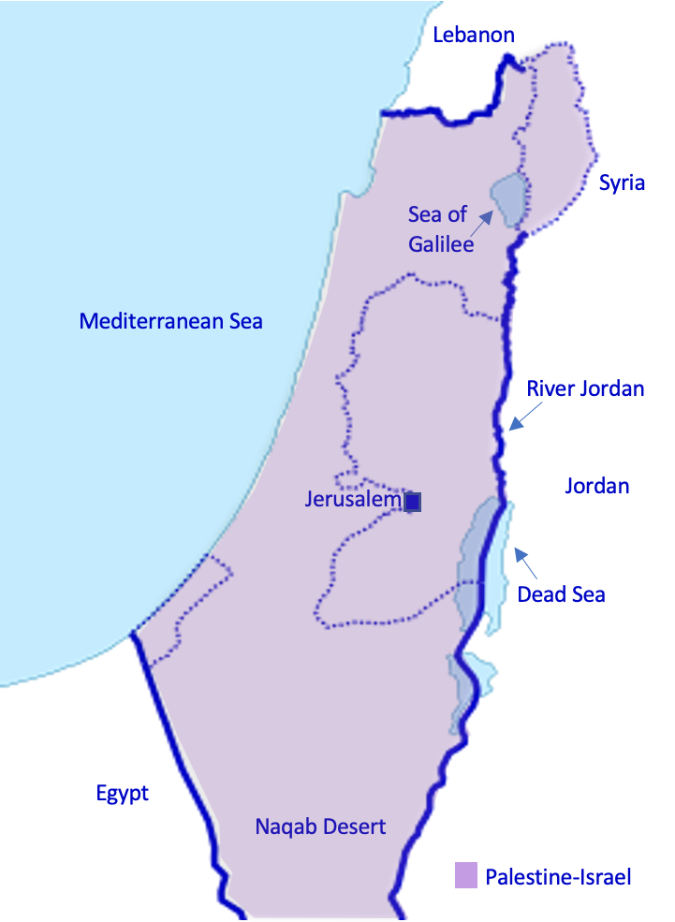
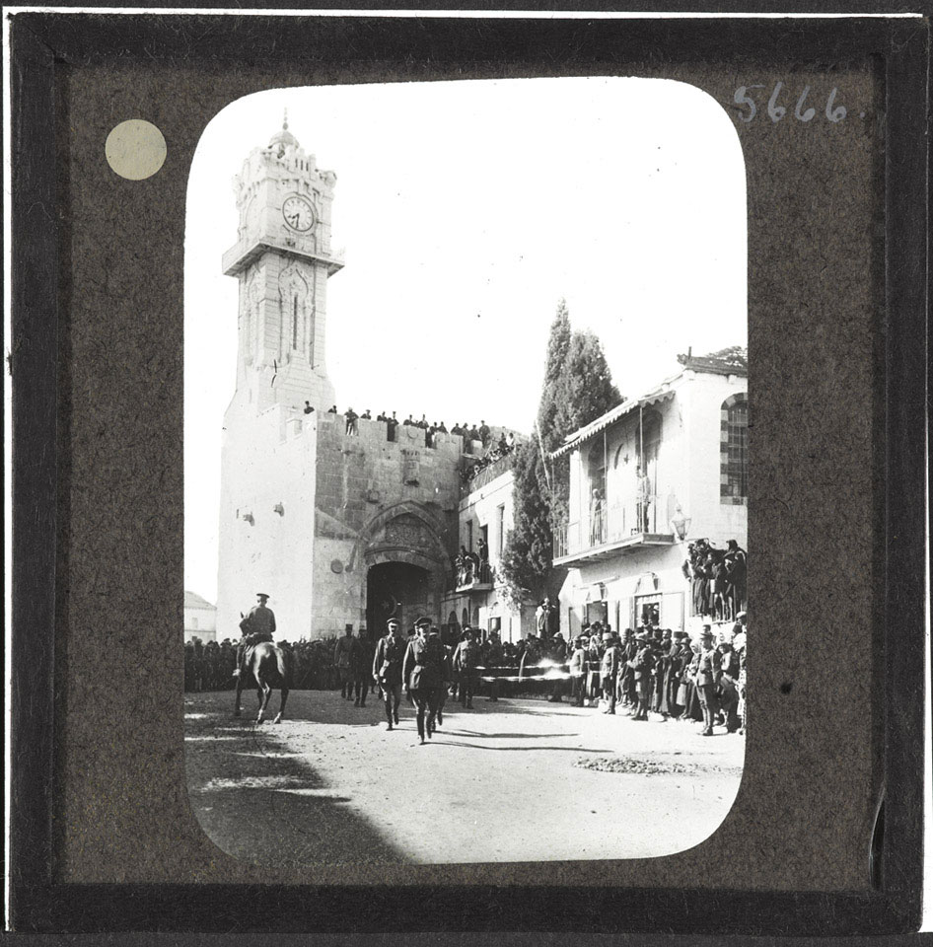


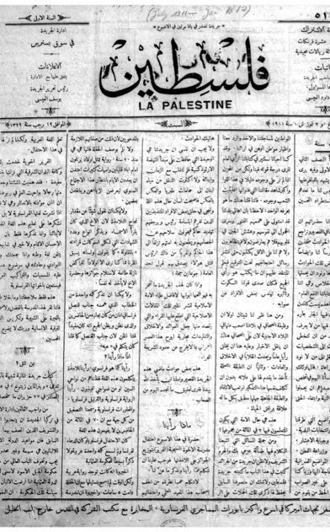
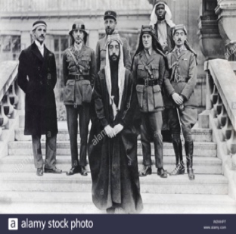
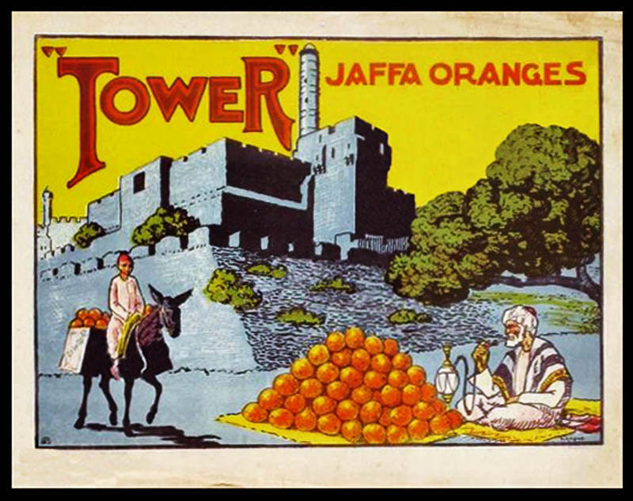
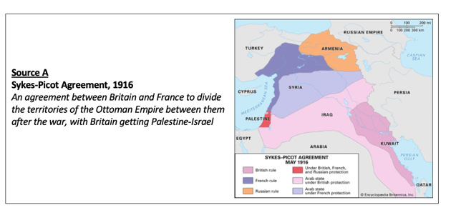
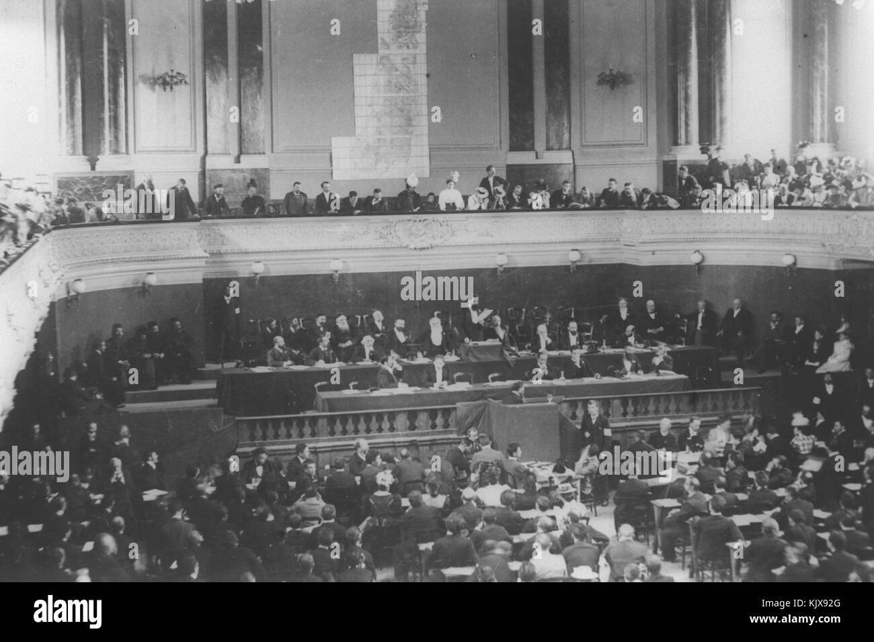
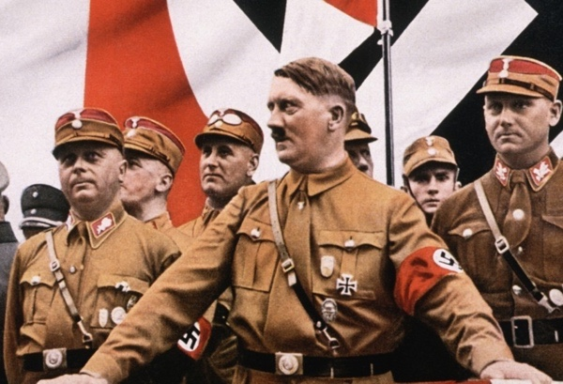
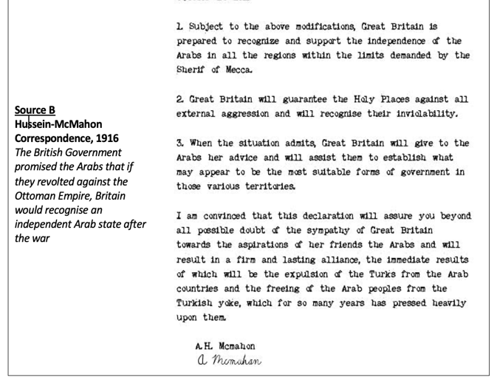
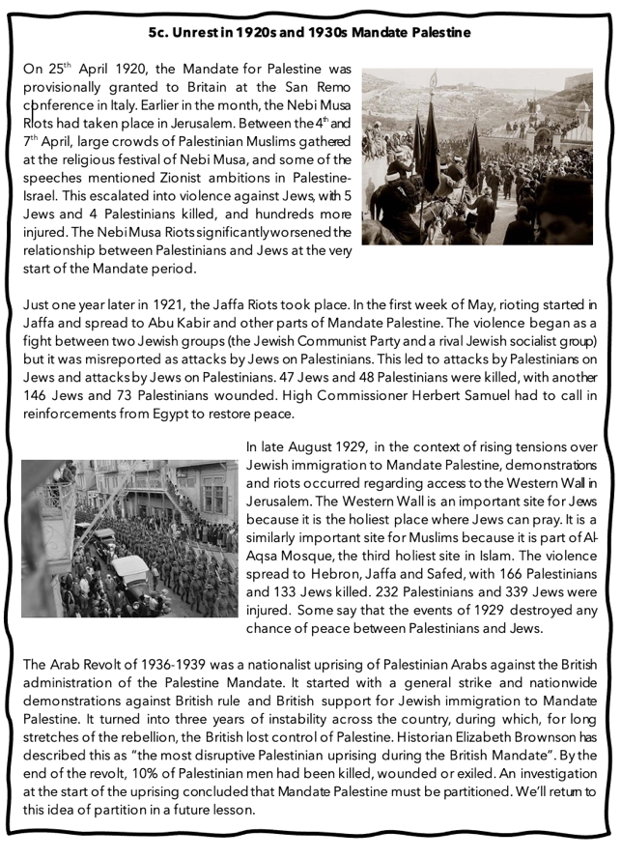
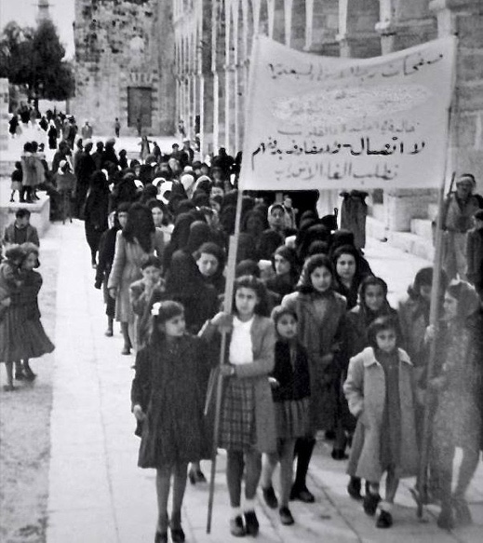
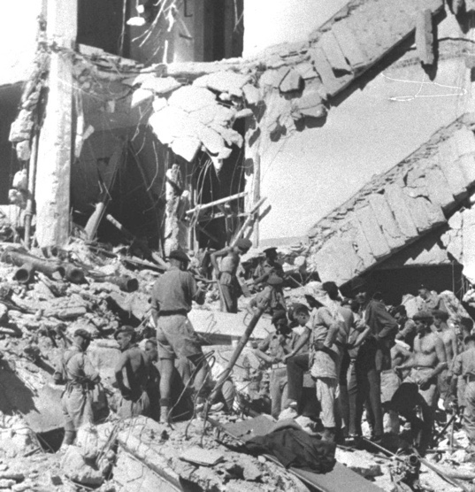
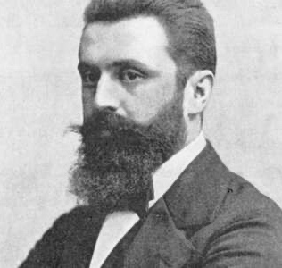
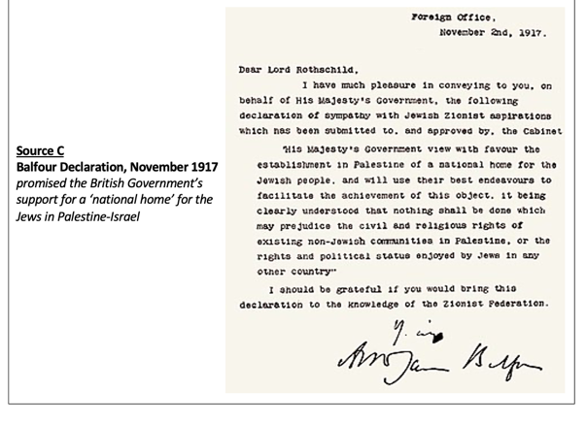
What did we cover in Chapter 1?

Slide 9
Chapter 1
L1: Was Palestine an ‘empty land’ in the nineteenth century?
L2: Why was Zionism established in the nineteenth century?
L3: What are the origins of the Palestinian national movement?
L4: Why did Britain govern Palestine-Israel between 1920 and 1948?
L5: What happened in 1920s and 1930s Mandate Palestine?
L6: What were the consequences of WW2 for Mandate Palestine?
L7: What were the consequences of the Nakba for the Palestinians?

Slide 10
Chapter Two Recap

Slide 11
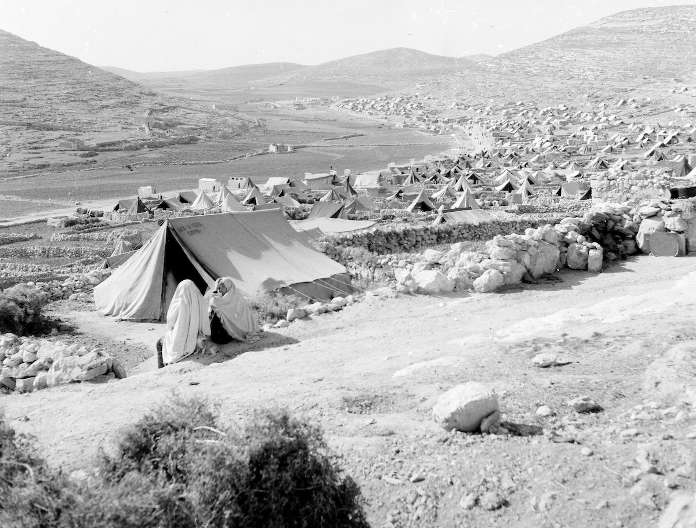
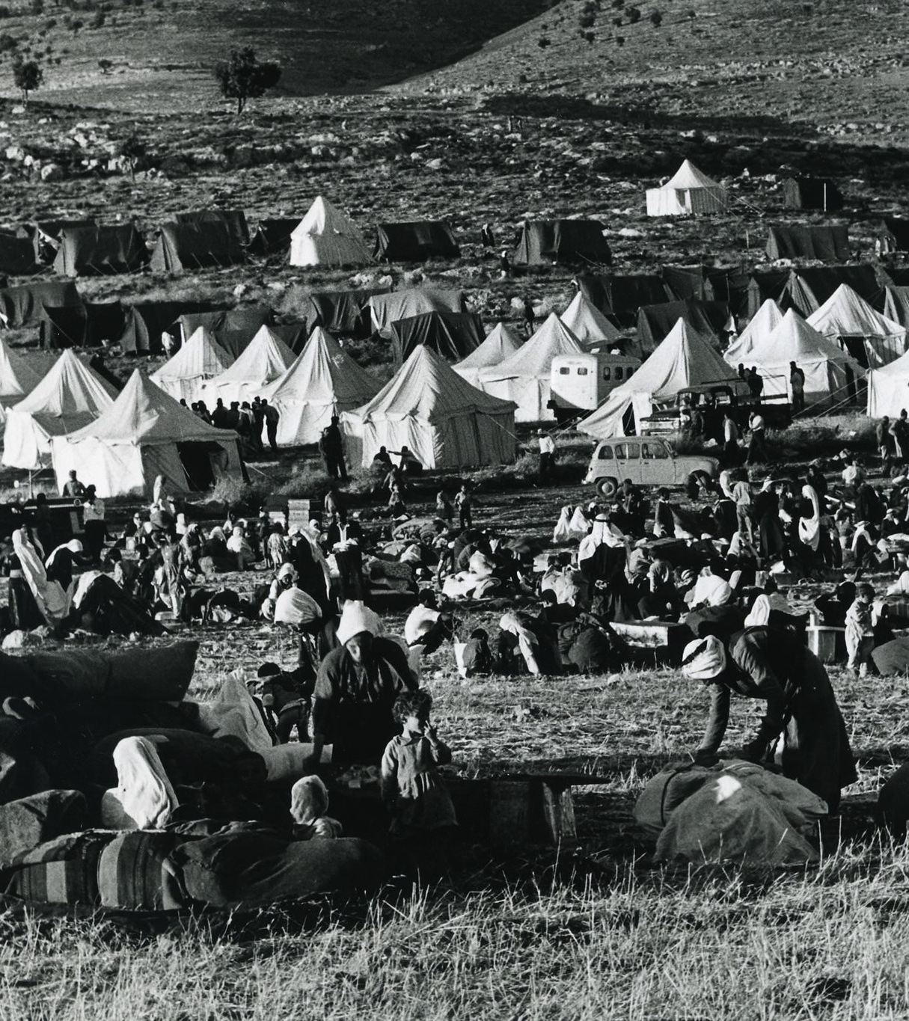
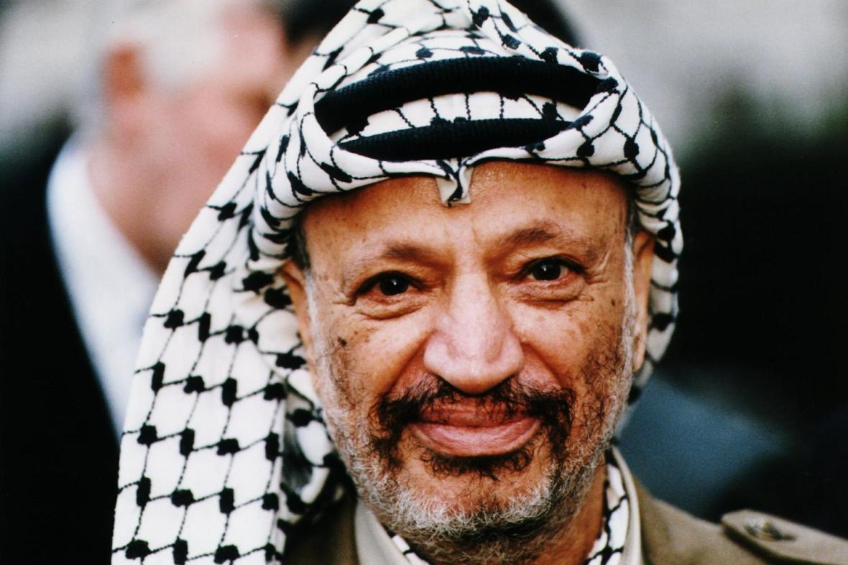
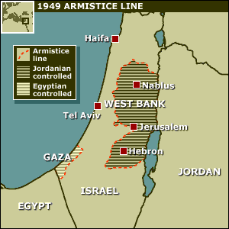
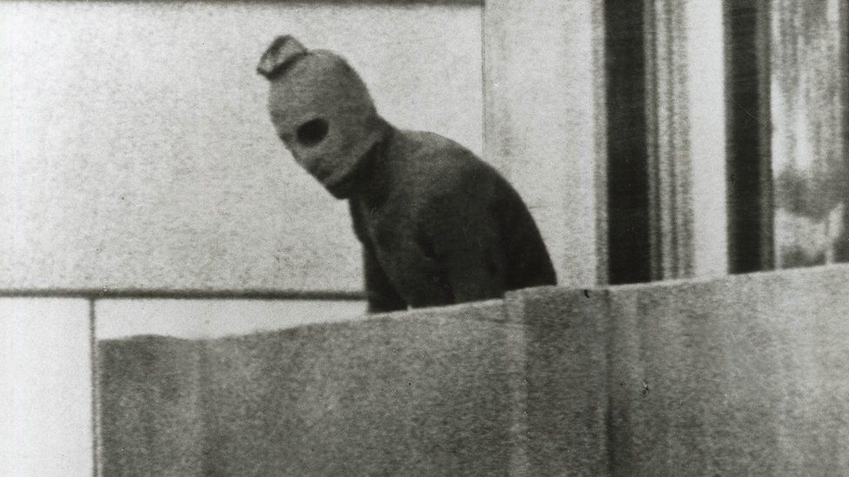
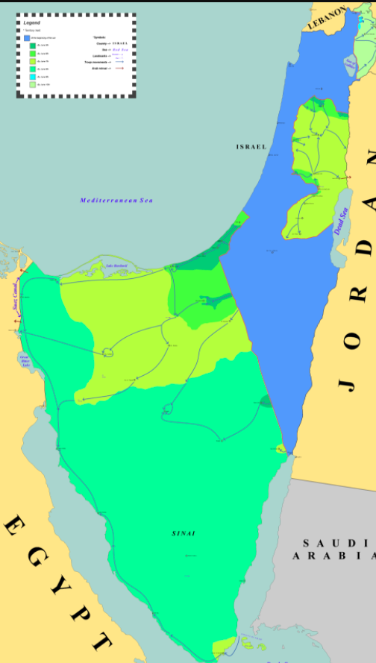
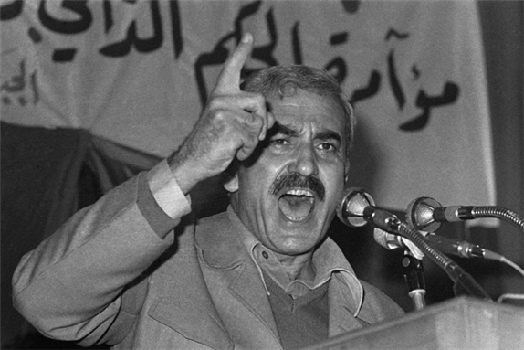
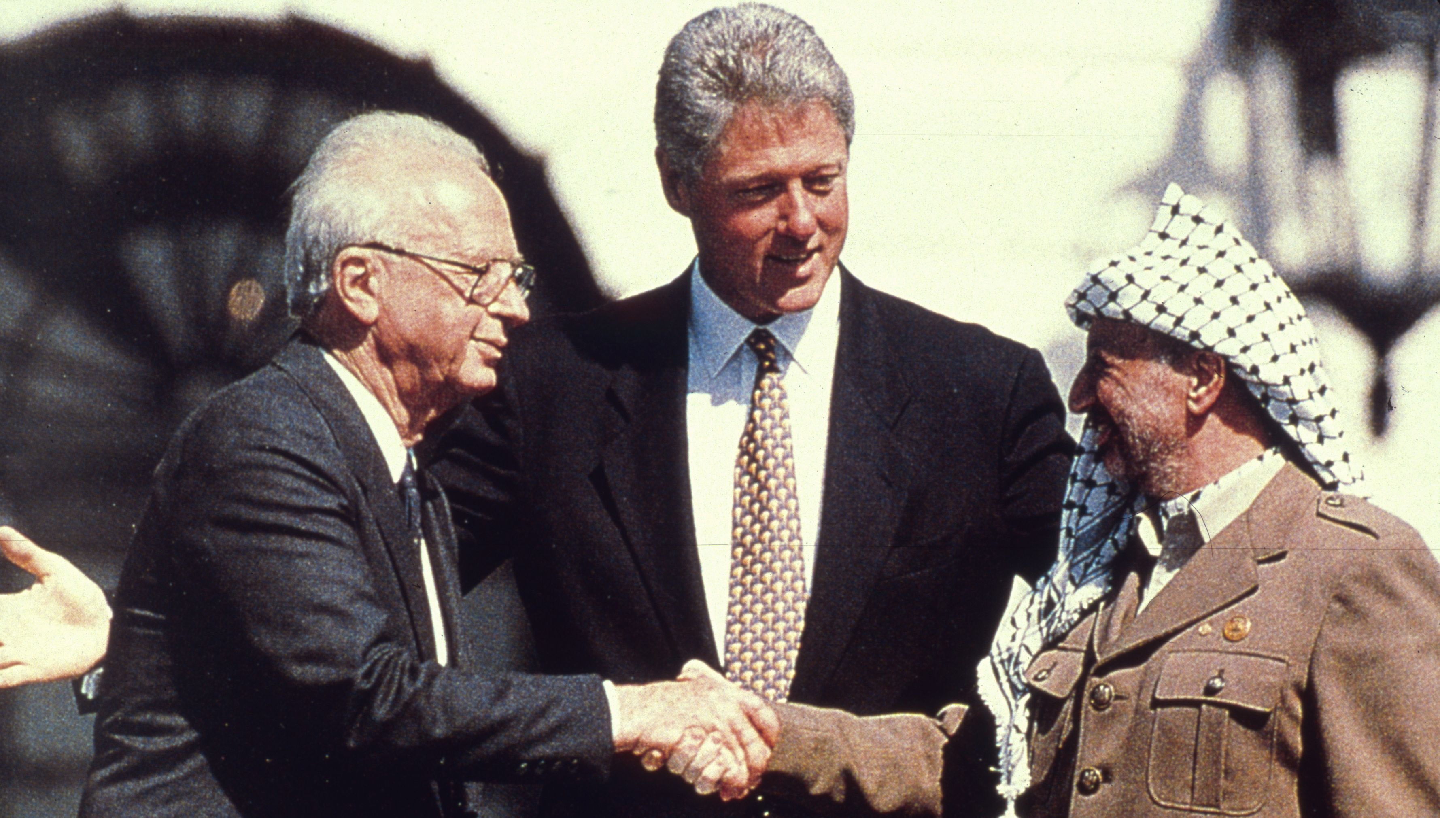

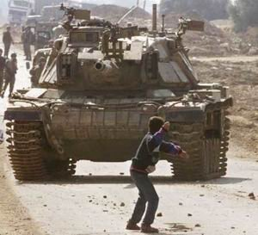

What did we cover in Chapter 2?

Slide 12
Chapter 2
L8: What happened in the 1950s?
L9: What were the consequences of the June 1967 War?
L10: How did Palestinian nationalism change in the 1960s and 1970s?
L11: What were the causes and consequences of the First Intifada?
L12: How successful were the Oslo Accords?
L13: What were the consequences of the Second Intifada for Palestine-Israel?

Slide 13
20a. In pairs, cut out the cards below and match the key events & dates:
Create a timeline in your book and stick the cards in
A massive uprising of Palestinians against Israeli occupation takes place, known as the First Intifada
Israel and the PLO agree to work together to achieve peace in the Oslo Accords but they fail
Following the 2006 Palestine election, Israel imposes an air, land and sea blockade on Gaza
1948
1800s
The Ottoman Empire falls apart during WWI
Britain is given a ‘Mandate’ to govern Palestine by the League of Nations
14th May 1948
Britain is to leave Palestine and the UN votes that Palestine will be partitioned into Israel and Palestine
1897
1967
Israel illegally annexes East Jerusalem
1914-1918
The state of Israel is established, and the rest of Palestine is now governed by Jordan and Egypt
2007
Early 1920s
Another massive Palestinian uprising occurs, known as the Second Intifada
A six-day war takes place between Israel, Egypt, Jordan and Syria. As a result, Israel occupies all of historic Palestine
1993 & 1995
2nd November 1917
The Nakba takes place and 750,000 Palestinians are forced to leave their homes
1980
November 1947
Palestine becomes modernised as part of the Ottoman Empire
Leading international human rights organisations report that Israel is committing the crime of apartheid against Palestinians
2021 -2022
The Zionist movement emerges and holds its first congress
2000-2005
1987-1993
Balfour promises British support for a ‘national home’ for Jews in Palestine
Extension question: what else could you add to this timeline?

Slide 14
Palestine becomes modernised as part of the Ottoman Empire
1800s
A massive uprising of Palestinians against Israeli occupation takes place, known as the First Intifada
1987-1993
The Nakba takes place and 750,000 Palestinians are forced to leave their homes
The Zionist movement emerges and holds its first congress
1948
1897
Israel and the PLO agree to work together to achieve peace in the Oslo Accords but they fail
The state of Israel is established, and the rest of Palestine is now governed by Jordan and Egypt
1993 & 1995
The Ottoman Empire falls apart during WWI
1914-1918
14th May 1948
Another massive Palestinian uprising occurs, known as the Second Intifada
Balfour promises British support for a ‘national home’ for Jews in Palestine
2nd November 1917
2000-2005
A six-day war takes place between Israel, Egypt, Jordan and Syria. As a result, Israel occupies all of historic Palestine
1967
Following the 2006 Palestine election, Israel imposes an air, land and sea blockade on Gaza
Britain is given a ‘Mandate’ to govern Palestine by the League of Nations
2007
Early 1920s
Israel illegally annexes East Jerusalem
1980
Leading international human rights organisations report that Israel is committing the crime of apartheid against Palestinians
Britain is to leave Palestine and the UN votes that Palestine will be partitioned into Israel and Palestine
November 1947
2021 -2022

Slide 15
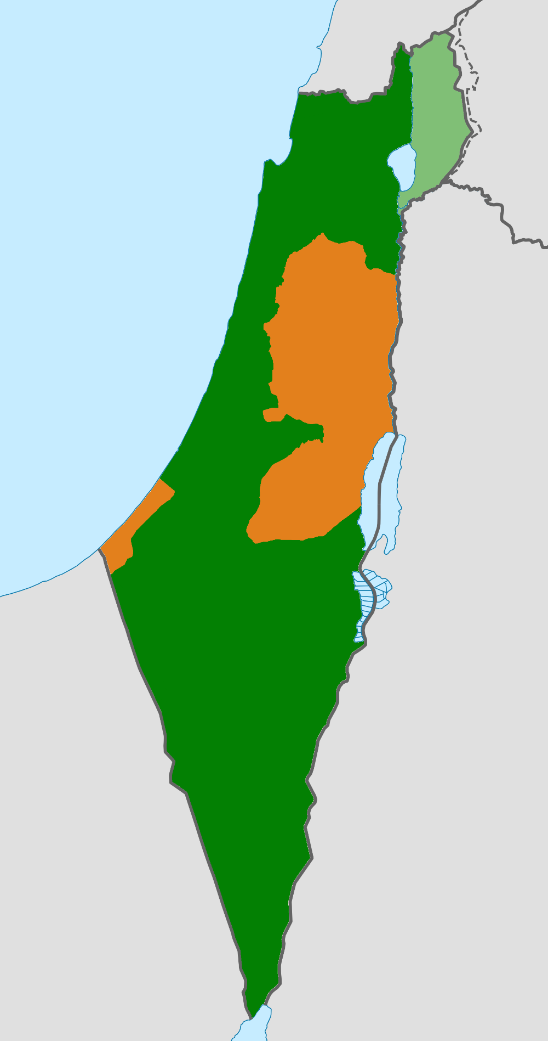
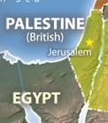
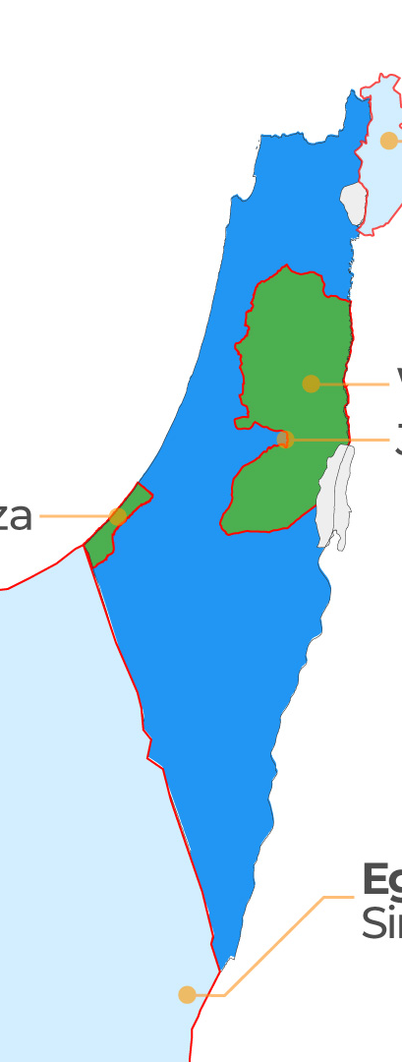
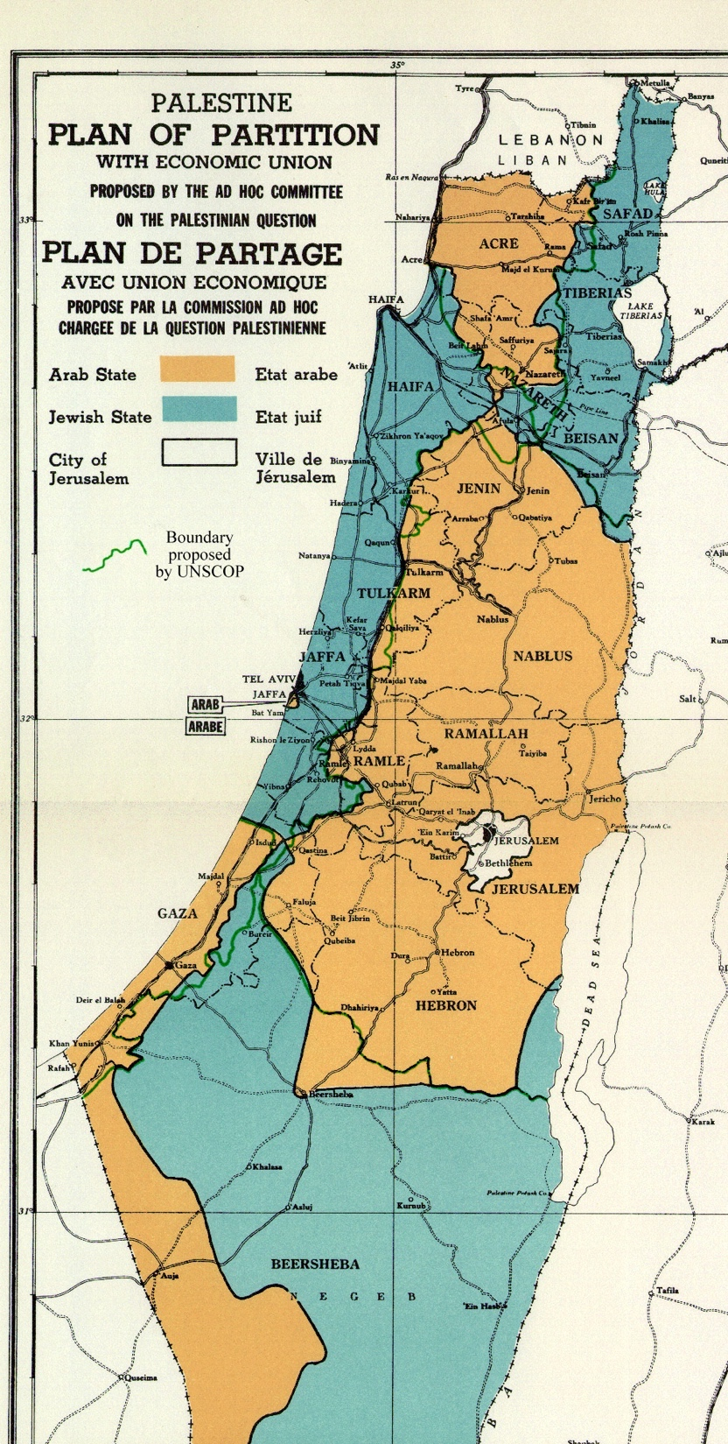
20b. The changing maps of Palestine-Israel
The plan for partitioning Palestine into ‘Palestine’ and ‘Israel’ before the 1948 war
Israel occupied all of historic Palestine during the Six Day War of 1967
The West Bank
Gaza
Israel
Israel and Jordanian-controlled and Egyptian-controlled Palestinian territory after the 1948 war
British Mandate to govern Palestine, from
1918 until 1948
Palestine-Israel
pre-1918, part of the Ottoman Empire
Israel and the occupied Palestinian territories of the West Bank and Gaza today
Stick this into your book

Slide 16
In pairs, using 20a and 20b, describe 2-3 differences between Palestine-Israel in the past and today
Why have these changes happened?

Slide 17
20c. True or false?
In Lesson 1, you wrote ‘true’ or ‘false’ under each of these statements. Without looking back at your answers from Lesson 1, do this again now:
“The Palestine-Israel issue has been raging for centuries!”
“Palestine was an ‘empty land’ in the nineteenth century!”
“Zionism is just another word for Judaism!”
“The Palestine-Israel issue is all about religion!”
“The Palestine-Israel issue is unique… you can’t compare it with anything else!”

Slide 18
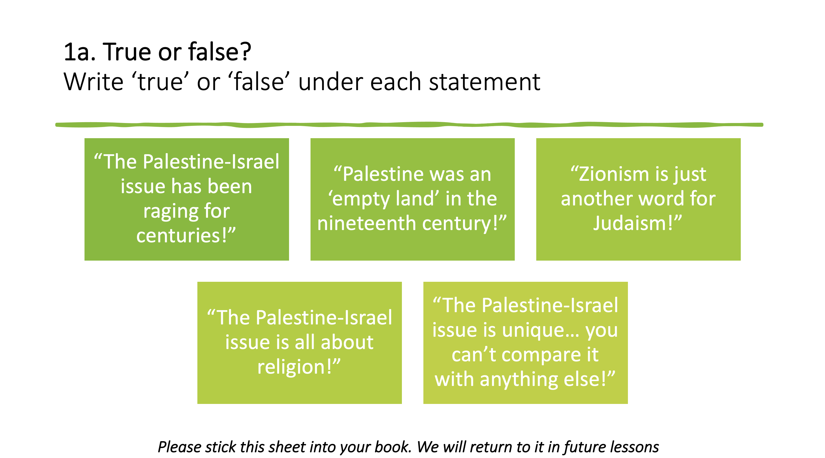
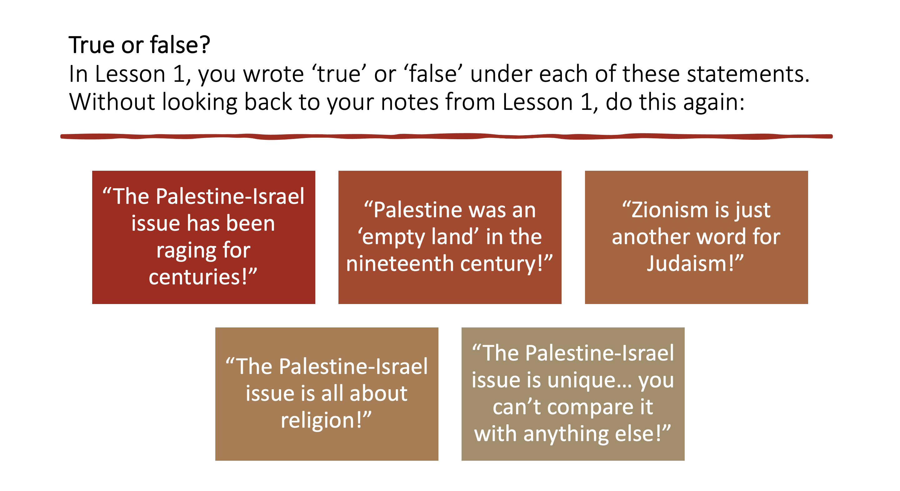
Working in small groups, compare your answers from Lesson 1 with your answers today.
What has changed? Why?

Slide 19
20d. Myth vs reality
Working in pairs, can you match up the myth with the reality?
“The Palestine-Israel issue has been raging for centuries!”
“Palestine was an ‘empty land’ in the nineteenth century!”
“Zionism is just another word for Judaism!”
“The Palestine-Israel issue is all about religion!”
“The Palestine-Israel issue is unique… you can’t compare it with anything else!”
There are religious differences between most Jews and Palestinians, but the main issue is the land
We can draw comparisons with apartheid in South Africa and ethnic cleansing in other places
Judaism and Zionism are not the same. Judaism is an ancient religion whereas Zionism is a 19th century political movement
In the nineteenth century, Palestine experienced modernisation and was flourishing
The Palestine-Israel issue started with the rise of nationalism in the late 1800s and early 1900s, for example Zionism

Slide 20
20d. Myth vs reality
Working in pairs, can you match up the myth with the reality?
“The Palestine-Israel issue has been raging for centuries!”
“Palestine was an ‘empty land’ in the nineteenth century!”
“Zionism is just another word for Judaism!”
“The Palestine-Israel issue is all about religion!”
“The Palestine-Israel issue is unique… you can’t compare it with anything else!”
The Palestine-Israel issue started with the rise of nationalism in the late 1800s and early 1900s, for example Zionism
In the nineteenth century, Palestine experienced modernisation and was flourishing
Judaism and Zionism are not the same. Judaism is an ancient religion whereas Zionism is a 19th century political movement
There are religious differences between most Jews and Palestinians, but the main issue is the land
We can draw comparisons with apartheid in South Africa and ethnic cleansing in other places

Slide 21
What should be done about the situation in Palestine-Israel?
In small groups, discuss the questions below. Be prepared to present your answers to the rest of the class.
What are the main barriers to peace, justice and equality in Palestine-Israel?
What can be done to reduce these barriers?
What should we do about the situation in Palestine-Israel?

Slide 22
Plenary
With the person next to you:
Describe and explain 3 changes over time in Palestine-Israel

